Slide 1
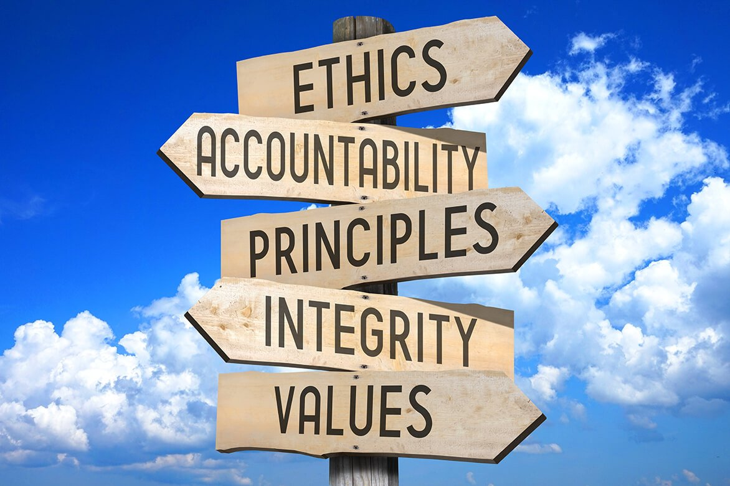
INTRODUCTION TO ETHICS
MODULE–1

Slide 2
CONTENTS
Moral
Ethics
Ethical Dilemma
Emotional Intelligence
Moral Development Theories (Kohlberg & Piaget)
Aristotle’s View on Ethics
Governing Factors of Value System
Personal Ethics
Professional Ethics

Slide 3
MORAL
A moral refers to an individual’s personal belief about what is right and wrong. Morals are shaped by family, culture, religion, education, and personal experiences.
Moral = Personal sense of right and wrong.
Examples
Telling the truth even when no one is watching.
Returning extra money received by mistake.
Helping an injured person on the road.
Example: Student returning lost wallet.
Sources of Morals
Family upbringing
Religion
Culture
Education
Traditions
Personal experience

Slide 4
Functions of Morals
Regulate human behavior
Distinguish right from wrong
Promote social harmony
Moral Responsibility
An individual is morally responsible when:
Action is voluntary
Person understands consequences
Characteristics
Personal in nature
Emotion-based
Learned from early life
Can change over time
Nature of Morals
Subjective in nature
Emotion-based
Informal rules
Learned from society

Slide 5
Importance
Shapes character
Influences daily decisions
Forms the base of ethics
For Example: If a student finds a lost mobile phone and returns it → moral action.
Moral Courage: Ability to stand for what is right despite pressure.
Example: An engineer refuses to approve unsafe material despite pressure from management.

Slide 6
ETHICS
Ethics is the systematic study of morals and moral behavior.
Ethics is a branch of philosophy that deals with principles of right and wrong.
Nature of Ethics
Rational
Logical
Systematic
Concerned with human conduct

Slide 7
Types of Ethics
Personal ethics
Professional ethics
Business ethics
Engineering ethics
Environmental ethics
Branches of Ethics
Meta-Ethics: Meaning of moral terms
Normative Ethics: What we should do
Applied Ethics: Engineering ethics, medical ethics, business ethics
Importance
Helps resolve conflicts
Improves decision making
Builds responsible professionals
Example: When someone using licensed software instead of pirated software.
Scope of Ethics
Individual behavior
Social relationships
Professional conduct

Slide 8
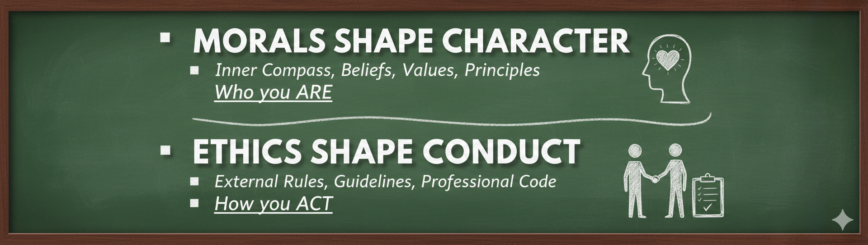
Morals shape character
Ethics shape conduct
Importance of Ethics for Engineers:
The engineering decisions always affect public safety
It helps in prevent misuse of technology
It maintains public trust
Helps in improve professional reputation

Slide 9
MORAL vs ETHICS
Moral
Ethics
Personal belief
Family, society
Individual
More flexible
Philosophical study
Reason & logic
Universal
More structured

Slide 10


ETHICAL DILEMMA
“Have you ever been confused between two choices where both seemed right?”
That confusion is called an Ethical Dilemma.
An ethical dilemma is a situation where:
You must choose between two options
Both options seem morally correct
But choosing one means losing the other
Right vs Right situation (Choosing between two rights)
It Is Difficult to take Because:
There is no perfect answer
Every choice has consequences
It involves values like honesty, loyalty, safety, responsibility

Slide 11
ETHICAL DILEMMA
A situation where a person must choose between two or more morally conflicting options, and no option is completely right.
Every choice results in some moral violation.
Characteristics
Involves two or more values
No completely right answer
Requires thinking and reasoning
Decision affects others
Example: When you report a senior’s mistake that may cause project failure.
Types
Personal vs Professional
Individual vs Society
Short-term vs Long-term good

Slide 12
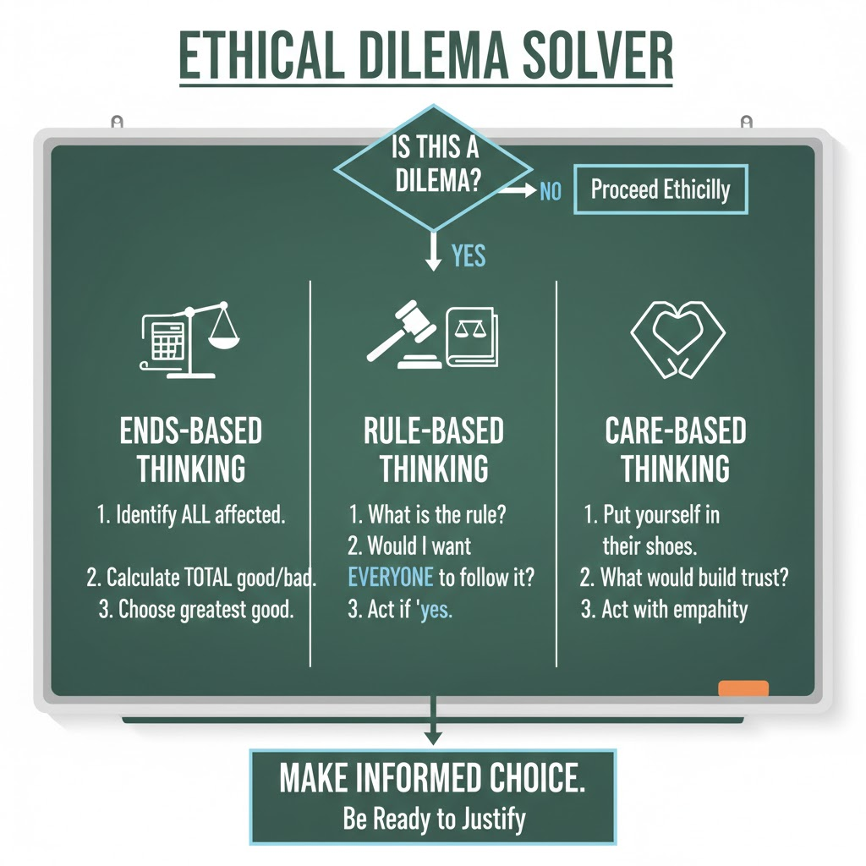
Steps to Solve Ethical Dilemma
Identify the problem
Identify stakeholders
List alternatives
Evaluate consequences
Choose best option
Importance
Develops reasoning ability
Enhances professional maturity

Slide 13
EMOTIONAL INTELLIGENCE (EI)
While Ethics and Morals provide the rules and character for making decisions, Emotional Intelligence (EI or EQ) is the engine that allows you to actually put those values into practice, especially under pressure.
Emotional Intelligence is the ability to recognize, understand, and manage your own emotions while also recognizing and influencing the emotions of others.
Components
Self-awareness
Self-regulation
Motivation
Empathy
Social skills
Benefits
Better leadership
Reduced conflicts
Ethical workplace culture

Slide 14
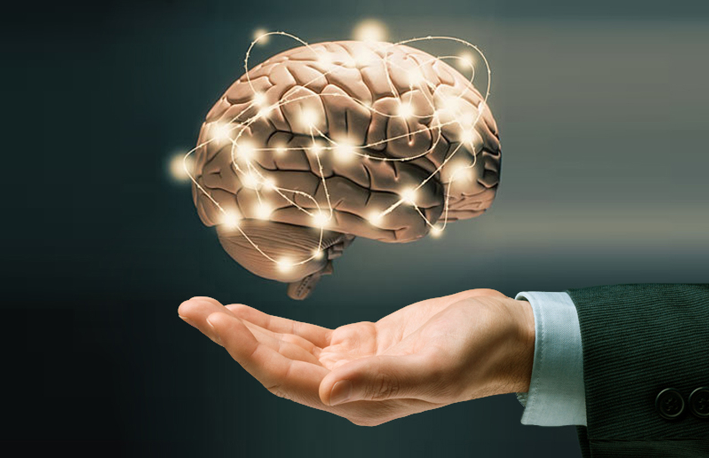
Emotional Intelligence is the ability to:
Understand your own emotions
Control your reactions
Understand others’ emotions
Manage relationships effectively
EI = Managing emotions intelligently

Slide 15
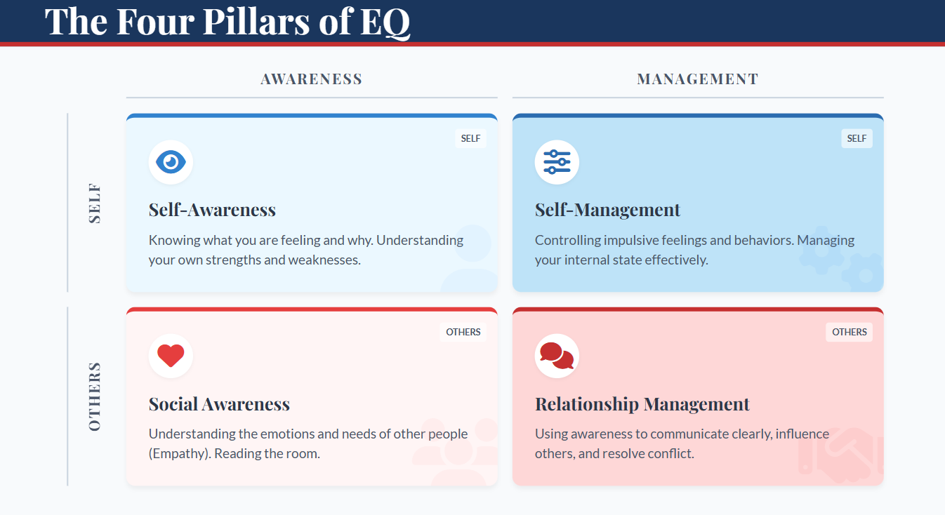

Slide 16
Importance of EI in Engineering Ethics
Everyone is facing:
Pressure from management
Tight deadlines
Ethical dilemmas
Conflict of interest
With EI:
Calm reasoning
Responsible behavior
Without EI:
Anger
Fear
Greed
Ego
May lead to unethical decisions.

Slide 17
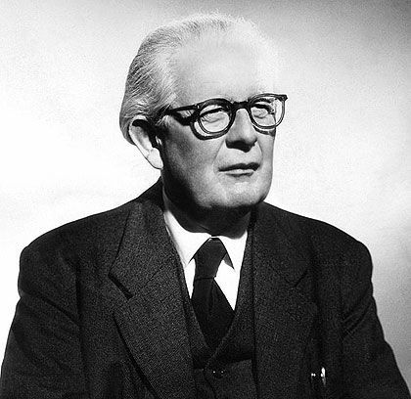
MORAL DEVELOPMENT THEORY – JEAN PIAGET
Morality is not something we are born with fully developed. As we grow, our understanding of right and wrong also grows. A child avoids wrong actions out of fear of punishment. An adult avoids wrong actions because of principles and responsibility. This growth in moral reasoning is called Moral Development.
Jean Piaget was a Swiss psychologist who studied how children develop thinking and reasoning abilities. He explained that moral understanding develops in stages as a child grows and Moral thinking changes with age and maturity.
Piaget said:
Children are not born with full moral understanding.
They gradually learn:
What is right and wrong
Why rules exist
Whether rules can change

Slide 18
Jean Piaget divided moral development into two main stages:
Stage 1: Heteronomous Morality (Usually seen in children below 10 years)
Children believe:
Rules are fixed and cannot be changed
Rules are made by authority (parents, teachers)
Breaking rules always deserves punishment
Stage 2: Autonomous Morality (Usually after 10 years and continues into adulthood)
Children begin to understand:
Rules are created by people
Rules can be changed by agreement
Intentions matter more than consequences
Characteristics:
Obedience to authority
Fear of punishment
Rigid thinking
No questioning of rules
Characteristics:
Flexible thinking
Understanding fairness
Mutual respect
Considering intentions

Slide 19
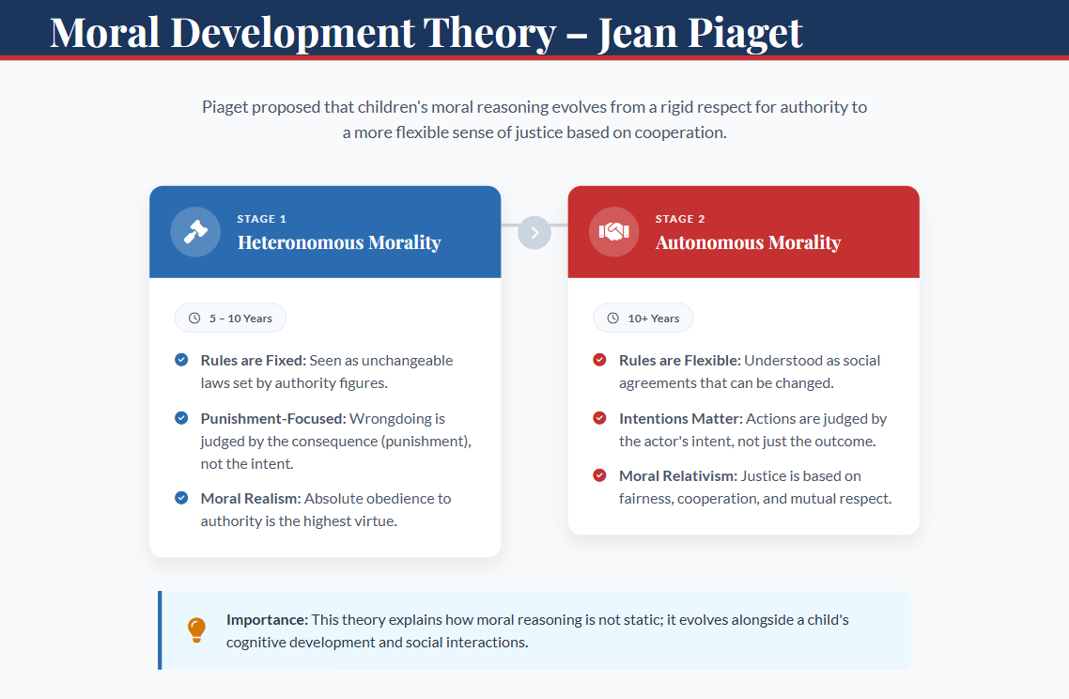

Slide 20
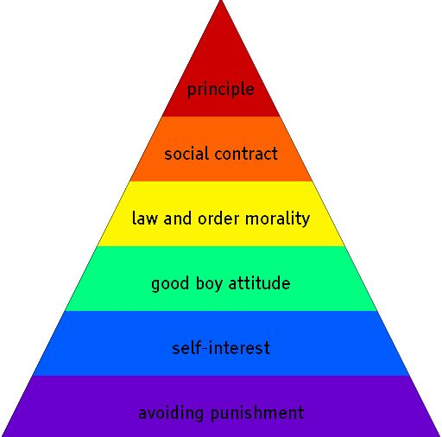
Moral Development Theory: (Lawrence Kohlberg)
Kohlberg explained how people develop moral thinking, that means how we decide what is right and wrong as we grow.
He said moral development happens in 3 levels and 6 stages.
Think of it like climbing steps from selfish thinking to ethical principles.
He proposed that moral reasoning evolves through three distinct levels:
Level I- Pre-Conventional | Level II- Conventional | Level III- Post-Conventional
Obedience & Punishment | Good boy/girl | Social contract
Self-interest | Law & order | Universal principles
Main Idea: Higher level → Higher ethical maturity.

Slide 21
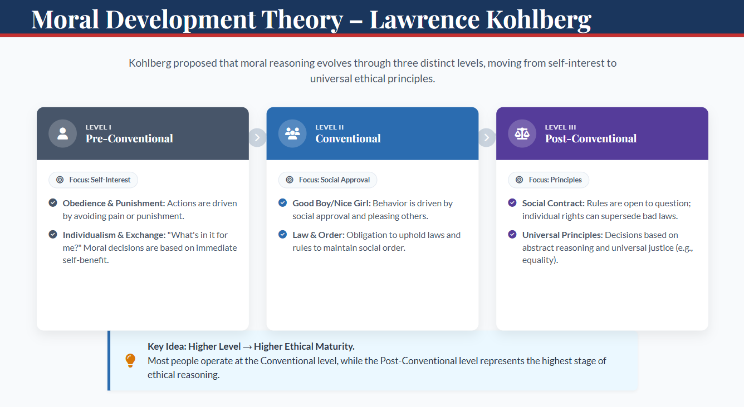

Slide 22
ARISTOTLE’S VIEW ON ETHICS
Core Idea : Purpose of life is happiness (Eudaimonia).
Aristotle believed that ethics is about developing good character. The goal of human life is to achieve happiness (Eudaimonia). But this happiness does not mean pleasure or money. It means living a meaningful life, being a good human being and fulfilling your potential. Aristotle’s ethics is known as Virtue Ethics. He introduced the concept of the Golden Mean, which states that virtue lies between two extremes.
What is Virtue?
According to Aristotle: Virtue means good habits that shape good character.
Examples: Honesty, Courage, Patience, Responsibility, Self-control etc.
He believed:
We are not born virtuous.
We become virtuous through practice.

Slide 23
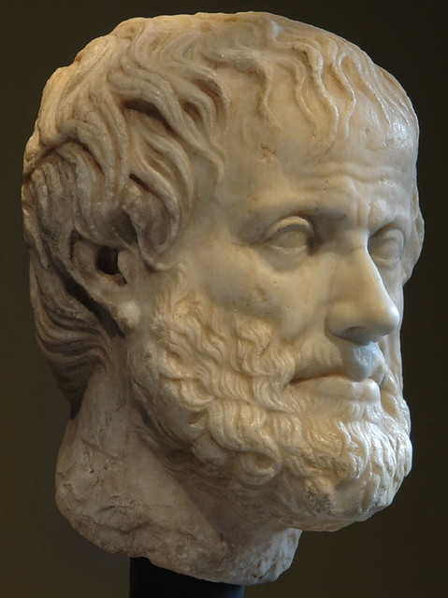
Too Little | Virtue (Middle) | Too Much
Cowardice | Courage | Recklessness
Laziness | Hard work | Workaholism
Silence | Confidence | Arrogance
The Golden Mean
Aristotle said: Virtue lies between two extremes. This is called the Doctrine of the Mean (Golden Mean).
Too much or too little is bad.
Balance is virtue.
Focus on Character, Not Rules
Unlike rule-based ethics, Aristotle focused on: “Who you are” rather than “What rule you follow.”
He believed: Good actions come from good character.

Slide 24
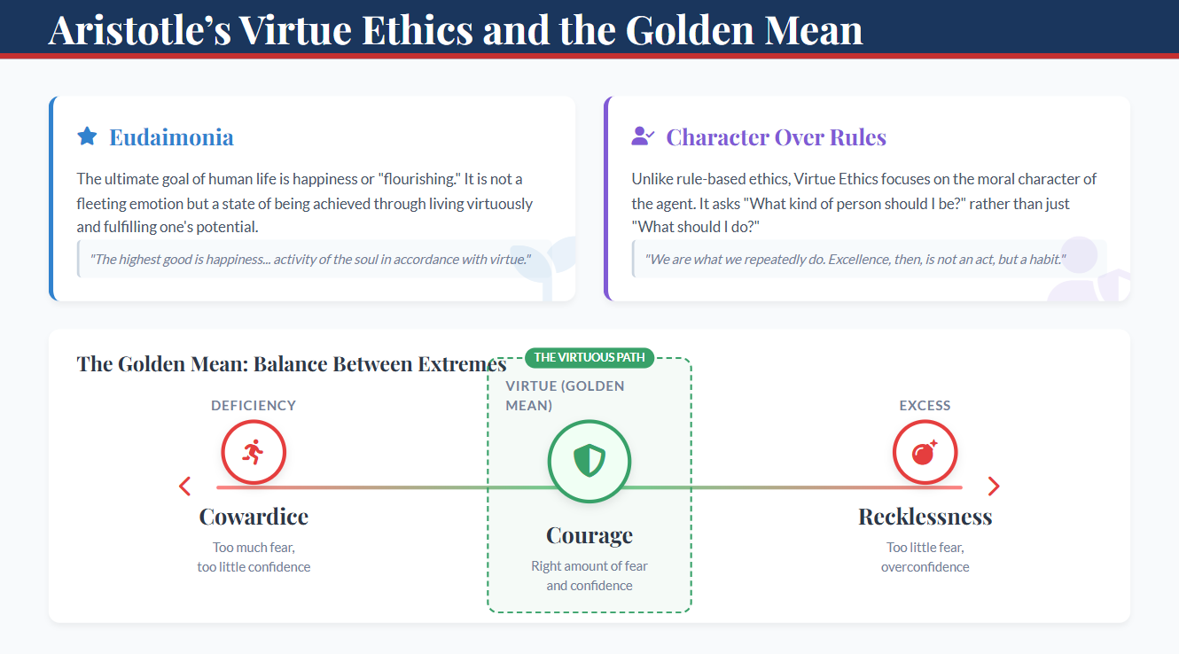

Slide 25
GOVERNING FACTORS OF VALUE SYSTEM
A value system refers to the set of beliefs, principles, and standards that guide a person’s behavior and decision-making. A value system is the internal guide that tells us what is right or wrong, important or unimportant. These values are influenced by several factors called Governing Factors of Value System.
Example: Values like honesty, respect, responsibility, and fairness influence our actions.
Governing Factors of Value System
Family Influence: Family is the first and most powerful source of values.
Education and Teachers: Schools and teachers play a major role in shaping moral values.
Culture and Society: Every society has its own beliefs, traditions, and customs that influence values.
Religion and Spiritual Beliefs: Religious teachings often guide moral values such as: compassion, honesty, forgiveness, service to others
Peer Group and Friends: Friends and colleagues strongly influence behavior, especially during youth.
Media and Technology: Modern media such as television, social media, internet, films can influence people's attitudes and beliefs.
Personal Experience: Life experiences shape how individuals view right and wrong. Success, failures, and challenges help people develop maturity and ethical understanding.

Slide 26
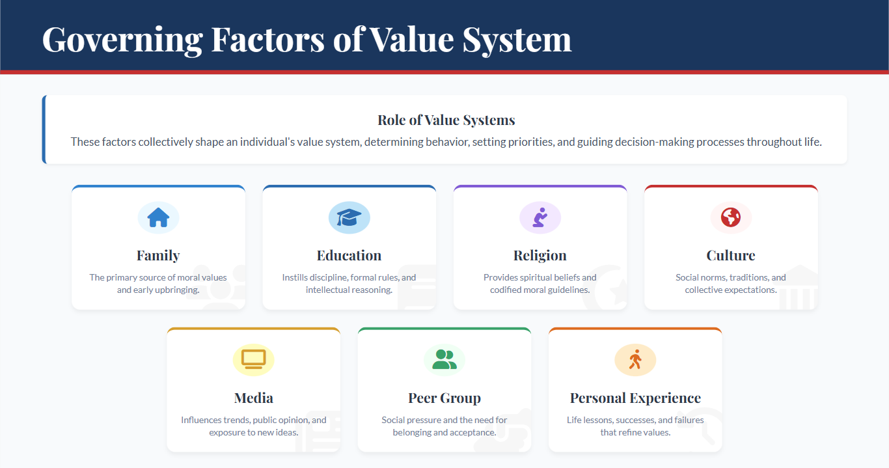

Slide 27

PERSONAL ETHICS
Personal ethics are the moral values and principles that guide an individual’s behavior in everyday life. These ethics come from a person’s beliefs, upbringing, culture, education, and experiences.
Personal ethics are the values a person follows in his or her personal life.
Examples: Honesty, Integrity, Discipline, Respect etc.
Characteristics of Personal Ethics
Individual in nature: Different people may have different values.
Developed from childhood: Influenced by family, society, and education.
Guides personal behavior: Helps decide what is right or wrong.
Not formally written: These are internal beliefs.
Importance:
Builds good-character
Develops trust and credibility
Helps in making moral decisions
Creates responsible citizens

Slide 28
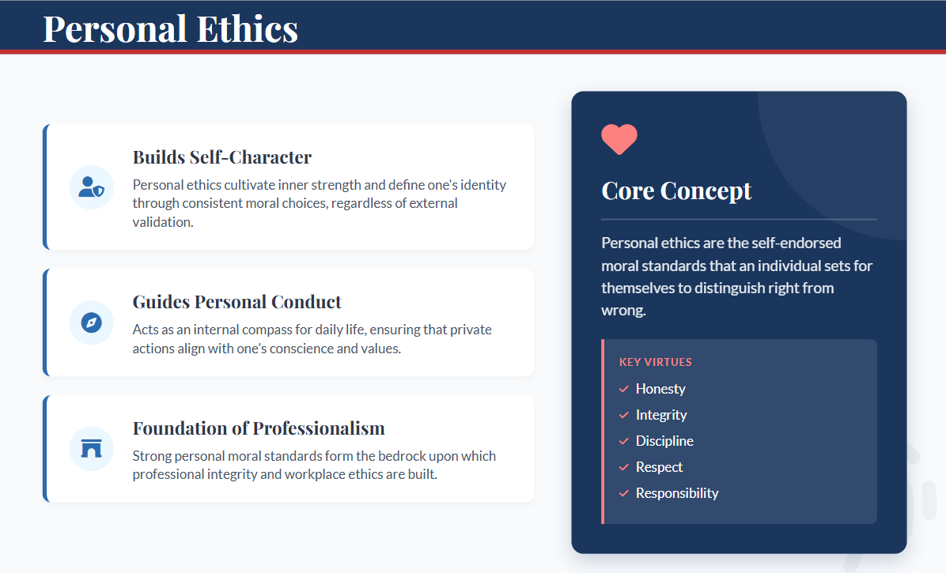

Slide 29

PROFESSIONAL ETHICS
Professional ethics are the rules, standards, and principles that guide behavior in a profession. These ethics ensure that professionals perform their duties responsibly, honestly, and competently. Professional ethics are the standards that guide behavior at the workplace.
Characteristics of Professional Ethics
Applies to a specific profession
Often written in codes or guidelines
Focuses on responsibility and accountability
Protects public interest
Principles
Integrity
Accountability
Confidentiality
Competence
Objectivity
Examples:
Ensuring public safety in designs
Maintaining accuracy in calculations
Protecting confidential company information
Avoiding corruption and bribery
Reporting safety risks
Importance
Public trust
Professional reputation
Organizational success

Slide 30
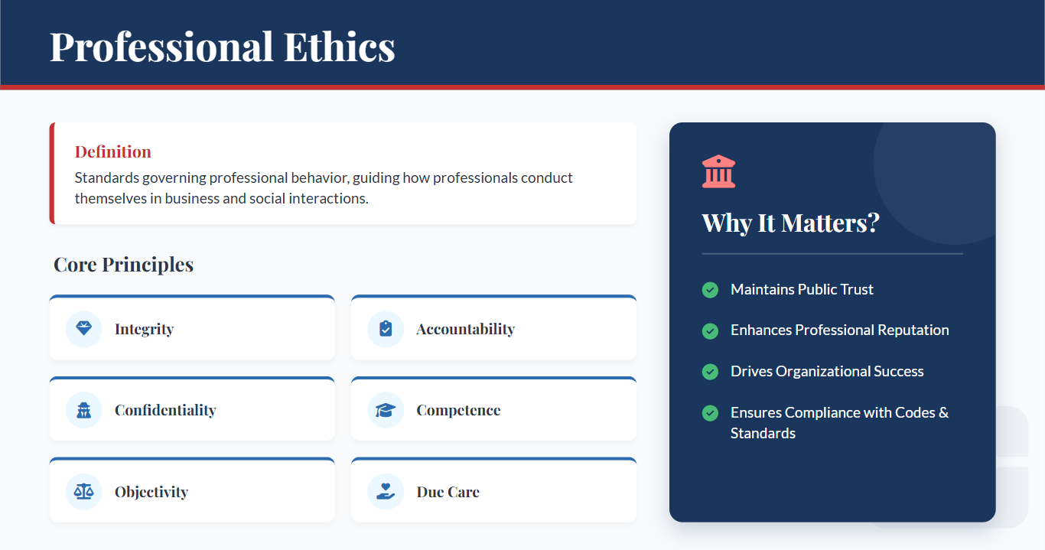

Slide 31
